Slide 1
3D OUTFIT CUSTOMIZER

Slide 2

Anjuman-I-Islam’s M.H. Saboo Siddik Polytechnic
Prepared By:
210451 – Abdurrahman Qureshi
210455 – Mohd Oaish Azher Qazi
220486 – Shaikh Mohd Hussain
Branch: CO Sem: 5th
Sub: Capstone Project Planning (22058)
Guided by: Ms. Zaibunnisa malik &
Ms. Salima khatib

Slide 3
Contents
Introduction & Specifications
Problem Statement
Objectives
Scope
Advantages
Disadvantages
Methodology
System Design
Software Design Approach
Timeline Chart
Gantt Chart

Slide 4
Introduction
& Specifications

Slide 5
Problem Statement
Many online fashion platforms don't fully address diverse preferences. Customization options are often limited, limiting creative expression. The lack of a 3D customization solution makes this issue worse. Introducing a 3D outfit customizer aims to change the digital fashion experience by letting users bring their unique ideas to life.

Slide 6
Objectives
1.
To study the 3D Outfit
Customizer Systems
To enable users to design and personalize outfits in a 3D virtual environment
3.
To curate a collection of
clothing items, fabrics, styles, patterns to choose from
To offer a user-friendly interface accessible on various devices
2.
4.

Slide 7
Scope
1.
A Collection of clothing items, fabrics, styles, patterns to
choose from & customize
Realistic 3D previews to visualize designs
3.
A 3D virtual design studio
for outfit creation and customization
A user-friendly interface accessible on various
devices
2.
4.

Slide 8
Advantages
Facilitating user empowerment in crafting outfits that resonate with their distinctive style.
Presenting accurate design visualization through realistic 3D models.
Efficiently streamlining the shopping process by centralizing the creation and purchase of personalized outfits.
Ensuring a pleasurable and interactive online shopping experience for our clientele.

Slide 9
Disadvantages
Technical challenges related to achieving realistic 3D rendering.
Limitations in accurately representing fabric textures in the 3D model.
Complexity in maintaining website performance

Slide 10
II. Methodology

Slide 11
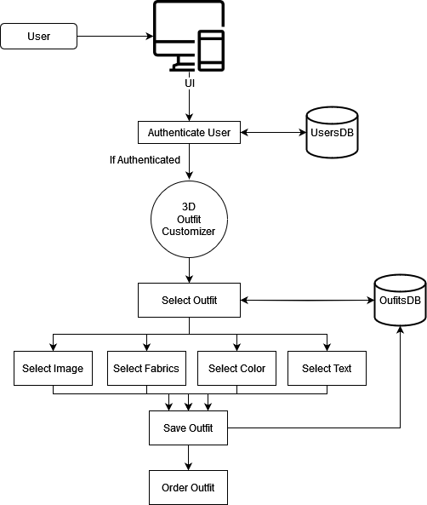
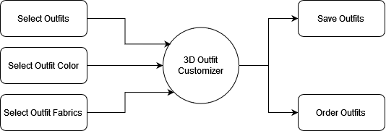
System Design
1. Block Diagram
2. System Architecture Diagram

Slide 12
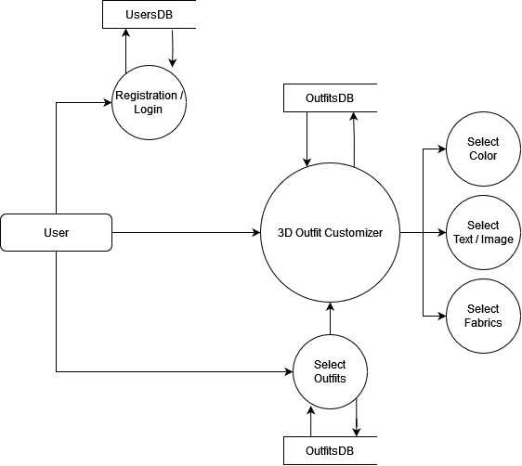

3. Data Flow Diagram
Level 0
Level 1

Slide 13
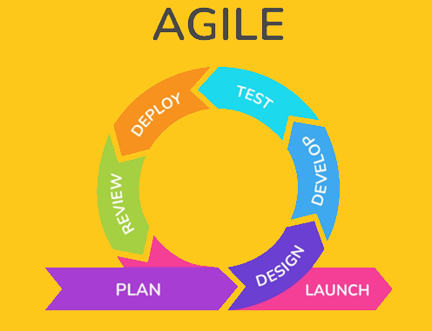
Software Design Approach

Slide 14
Timeline Chart

Slide 15
Gantt Chart

Slide 16
Thank You

